Slide 1

CARA
By Tolu Aibana and Terry Zeng

Slide 2
Executive Summary
PROBLEM
SOLUTION
IMPACT
Canadian postsecondary students are struggling to get access to Mental Health resources.
Provide a platform that can aid students manage their mental well being.
A positive increase in the mental well being of Canadian Students.
Executive Summary
Market Opportunity
Product
Demo
Conclusion

Slide 3
Meet Sam.
“
Being a student is hard. Trying to balance school, a part-time job, and a social life is exhausting. I often feel stressed, and don’t know how much longer I can hold up. I need help.
“
Executive Summary
Market Opportunity
Product
Demo
Conclusion
Notes:
Question – why aspirational positioning?

Slide 4
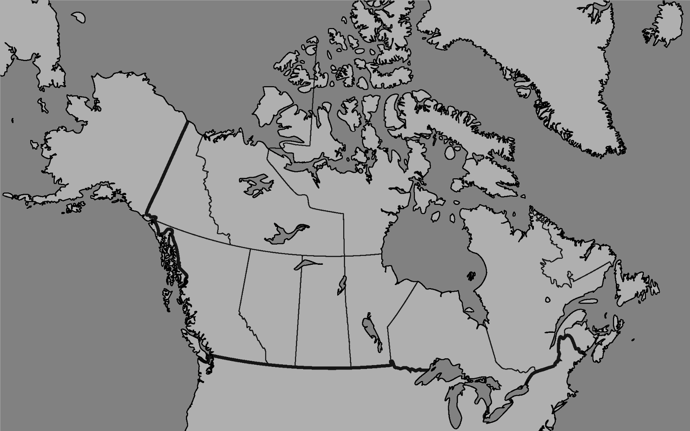
1/5th of Canadian postsecondary students are depressed and anxious or battling other mental health issues.
A study found that 12% of young adults reported seeking professional mental health services in the past year
Executive Summary
Market Opportunity
Product
Demo
Conclusion
Notes:
Question – why aspirational positioning?

Slide 5
“
It’s frustrating trying to get help from the stress I feel from school work and exams. The school told me wait times for a counsellor could be weeks!
“
Executive Summary
Market Opportunity
Product
Demo
Conclusion
Notes:
Question – why aspirational positioning?

Slide 6

Problem: Accessibility
An Average Psychologist Appointment costs $75 - $150 per hour.
Students can expect long wait times when seeking a School provided Counsellor.
Market Opportunity
Product
Demo
Conclusion
Executive Summary
Notes:
Question – why aspirational positioning?

Slide 7


Cara:
The Bot that Cares

Slide 8

Who Is Cara?
Listen.
User ”messages” Cara about their daily experiences while Cara documents your thinking patterns.
Understand.
Cara will perform sentiment analysis on these conversations to create an individualized data profile on the specific user.
Advise.
Cara uses the collected and analyzed data to identify harmful thinking patterns, and suggests tips to cope.
A Virtual Psychologist
Executive Summary
Market Opportunity
Product
Demo
Conclusion
Notes:
Question – why aspirational positioning?

Slide 9
Partnerships
CMHA engages with more than 1.3 million Canadians annually.
Provide access to Mental Health research & data for the machine.

Slide 10
Partnerships
Machine Learning
Natural Language Classifier
Personality & Tone Analyzer

Slide 11
Product Fit
Old Experience
New Experience
Students paying for expensive Counselling appointments.
Students pay a small subscription fee for online individualized counselling.
Cost
Students waiting weeks to see a free school Counsellor.
Students have immediate access to the help they need via their devices.
Time
Executive Summary
Market Opportunity
Product
Demo
Conclusion
Notes:
Question – why aspirational positioning?

Slide 12
Demo
Executive Summary
Market Opportunity
Product
Demo
Conclusion
Notes:
Question – why aspirational positioning?

Slide 13
Cara:
The Bot that Cares

